Slide 1

Rotten Tomatoes Movie Analysis
Project By: Abhijeet Ranjan

Slide 2

Contents
Introduction
KPI/ Objectives
Insights
Conclusion

Slide 3

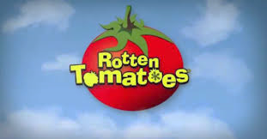
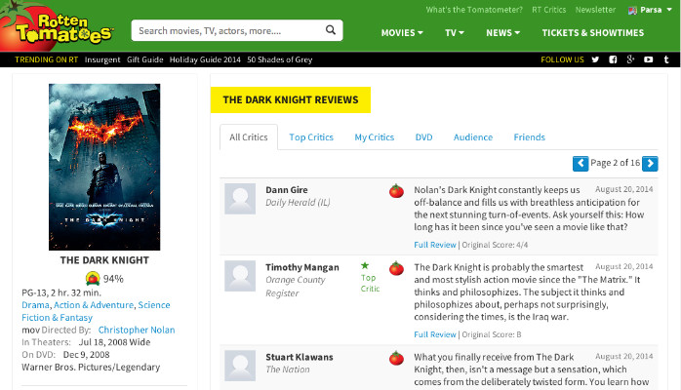
Introduction
The information on films can be found on many well-known websites, Rotten Tomatoes is the best source for critic reviews. Rotten Tomatoes and the Tomatometer score are the world’s most trusted recommendation resources for quality entertainment. As the leading online aggregator of movie and TV show reviews from critics, we provide fans with a comprehensive guide to what’s Fresh – and what’s Rotten – in theaters and at home.

Slide 4
Objectives/ KPI
What does the distribution of films look like by rating? My primary genre? (hint: use the first genre listed)
What % of films received a Certified Fresh Tomatometer rating? What about Rotten?
Explore new film releases over time. How has the volume of releases by month trended over time? What year/month were the newest films released?
Compare average Tomatometer ratings by Studio. Which studios produce the highest-rated films, on average? The lowest?
Compare the Tomatometer ratings against audience ratings. Which films showed the largest discrepancies between audiences and critics?
Explore the critic's consensus rating: what language is used most often?

Slide 5
Insights
What does the distribution of films look like by rating? My primary genre? (hint: use the first genre listed)
Movies are released based on one of 6 rating categories: R, NR, PG-13, PG, G, and NC17. The movie's primary genre is comedy, followed by drama, action & adventure, and so on.
R: -Restricted – Under 17 requires accompanying parent or adult guardian.
NR: - If a film has not been submitted for a rating or is an uncut version of a film that was submitted, the labels Not Rated (NR) or Unrated (UR) are often used. PG13: - Parents strongly cautioned under age 13
PG: -Parental guidance suggested
G: - General audiences-All ages admitted
NC17: - No children under 17 admitted

Slide 6
Insights
What % of films received a Certified Fresh Tomatometer rating? What about Rotten?
17.77% of movies received Certified Fresh, 38.75% received Fresh and 43.47% received Rotten rating.

Slide 7
Insights
Explore new film releases over time. How has the volume of releases by month trended over time? What year/month were the newest films released?

Slide 8
Insights
Compare average Tomatometer ratings by Studio. Which studios produce the highest-rated films, on average? The lowest?
Row Labels | Average of tomatometer_rating | Count of movie_title
Paramount Pictures | 60.69416499 | 497
Warner Bros. Pictures | 56.93902439 | 492
Universal Pictures | 57.31130064 | 469
 | 68.68028846 | 416
20th Century Fox | 52.59178744 | 414
Grand Total | 59.1791958 | 2288

Slide 9
Insights
Compare the Tomatometer ratings against audience ratings. Which films showed the largest discrepancies between audiences and critics?
Comparison has provided between audience rating and Rotten Tomato-meter Rating. The Movie 96 Souls has the highest discrepancies between audiences and critics.

Slide 10
Insights
Explore the critic's consensus rating: what language is used most often?
76.10% of Critics consensus assessment are positive,14.26% are neutral and 9.64% are negative.

Slide 11
CONCLUSION
Excel was utilized in the study to find patterns and trends in the data, including the comedy genre’s highest rating count and differences between Tomato-meter and audience ratings for selected films. The data also revealed the studios with the lowest and greatest ratings, providing studios with a benchmark against which to measure their success and raise their ratings. The Analysis helps studios improve their performance and have more success in the film industry by offering insightful information about the elements that lead to high Tomato-meter scores for films with a “R” classification.

Slide 12




Thank You
www.linkedin.com/in/abhijeet-ranjan-958760191
abhijeetr162@gmail.com
abhijeetranjan
https://peerlist.io/abhijeetranjan

